Slide 1
Dis 03:
Recursion & Tree Recursion
TA: Anita Cu
anitacu5@berkeley.edu

Slide 2
Agenda
0 ) Administrivia
1 ) Recursion
2 ) Tree Recursion

Slide 3
Administrivia
MT 1 grades released
HW 3 released + due next Thursday 2/21
CSM sections !!

Slide 4
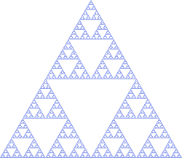
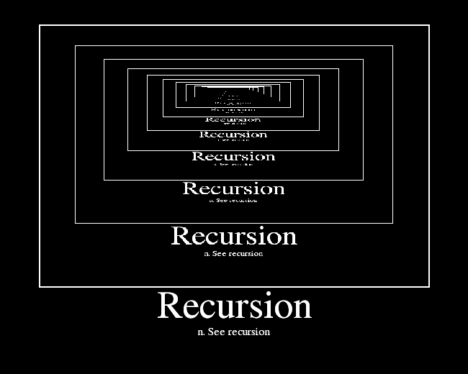
1
Recursion
Sierpinski Triangle

Slide 5
Recursion
recursive function: a function that calls itself

Slide 6
Recursion
recursive function: a function that calls itself
def factorial(n):
if n == 0 or n == 1:
return n
else:
return n * factorial(n-1)

Slide 7
Recursion
recursive function: a function that calls itself
1. Base Case
def factorial(n):
if n == 0 or n == 1:
return n
else:
return n * factorial(n-1)

Slide 8
Recursion
recursive function: a function that calls itself
1. Base Case
Simplest argument possible?
def factorial(n):
if n == 0 or n == 1:
return n
else:
return n * factorial(n-1)

Slide 9
Recursion
recursive function: a function that calls itself
1. Base Case
Simplest argument possible?
factorial(0) = 1 // by definition
def factorial(n):
if n == 0 or n == 1:
return n
else:
return n * factorial(n-1)

Slide 10
Recursion
recursive function: a function that calls itself
1. Base Case
Simplest argument possible?
factorial(0) = 1 // by definition
def factorial(n):
if n == 0 or n == 1:
return n
else:
return n * factorial(n-1)

Slide 11
Recursion
recursive function: a function that calls itself
1. Base Case
Simplest argument possible?
2. Recursive Call
def factorial(n):
if n == 0 or n == 1:
return n
else:
return n * factorial(n-1)

Slide 12
Recursion
recursive function: a function that calls itself
1. Base Case
Simplest argument possible?
2. Recursive Call with simpler argument
Take the “leap of faith”: simplify your problem by reducing some work and assume this recursive call works
def factorial(n):
if n == 0 or n == 1:
return n
else:
return n * factorial(n-1)

Slide 13
Recursion
recursive function: a function that calls itself
1. Base Case
Simplest argument possible?
2. Recursive Call with simpler argument
Take the “leap of faith”: simplify your problem by reducing some work and assume this recursive call works
factorial(n - 1)
def factorial(n):
if n == 0 or n == 1:
return n
else:
return n * factorial(n-1)

Slide 14
Recursion
recursive function: a function that calls itself
1. Base Case
Simplest argument possible?
2. Recursive Call with simpler argument
Take the “leap of faith”: simplify your problem by reducing some work and assume this recursive call works
factorial(n - 1)
def factorial(n):
if n == 0 or n == 1:
return n
else:
return n * factorial(n-1)

Slide 15
Recursion
def factorial(n):
if n == 0 or n == 1:
return n
else:
return n * factorial(n-1)
recursive function: a function that calls itself
1. Base Case
Simplest argument possible?
2. Recursive Call with simpler argument
Take the “leap of faith”: simplify your problem by reducing some work and assume this recursive call works
3. Use recursive call to solve overall problem.

Slide 16
Recursion
def factorial(n):
if n == 0 or n == 1:
return n
else:
return n * factorial(n-1)
recursive function: a function that calls itself
1. Base Case
Simplest argument possible?
2. Recursive Call with simpler argument
Take the “leap of faith”: simplify your problem by reducing some work and assume this recursive call works
3. Use recursive call to solve overall problem.
How can we use the result of our recursive call to solve our original problem?

Slide 17
Recursion
def factorial(n):
if n == 0 or n == 1:
return n
else:
return n * factorial(n-1)
recursive function: a function that calls itself
1. Base Case
Simplest argument possible?
2. Recursive Call with simpler argument
Take the “leap of faith”: simplify your problem by reducing some work and assume this recursive call works
3. Use recursive call to solve overall problem.
How can we use the result of our recursive call to solve our original problem?
n * (n-1)! ⇒ n * factorial(n-1)

Slide 18
Recursion
def factorial(n):
if n == 0 or n == 1:
return n
else:
return n * factorial(n-1)
recursive function: a function that calls itself
1. Base Case
Simplest argument possible?
2. Recursive Call with simpler argument
Take the “leap of faith”: simplify your problem by reducing some work and assume this recursive call works
3. Use recursive call to solve overall problem.
How can we use the result of our recursive call to solve our original problem?
n * (n-1)! ⇒ n * factorial(n-1)

Slide 19
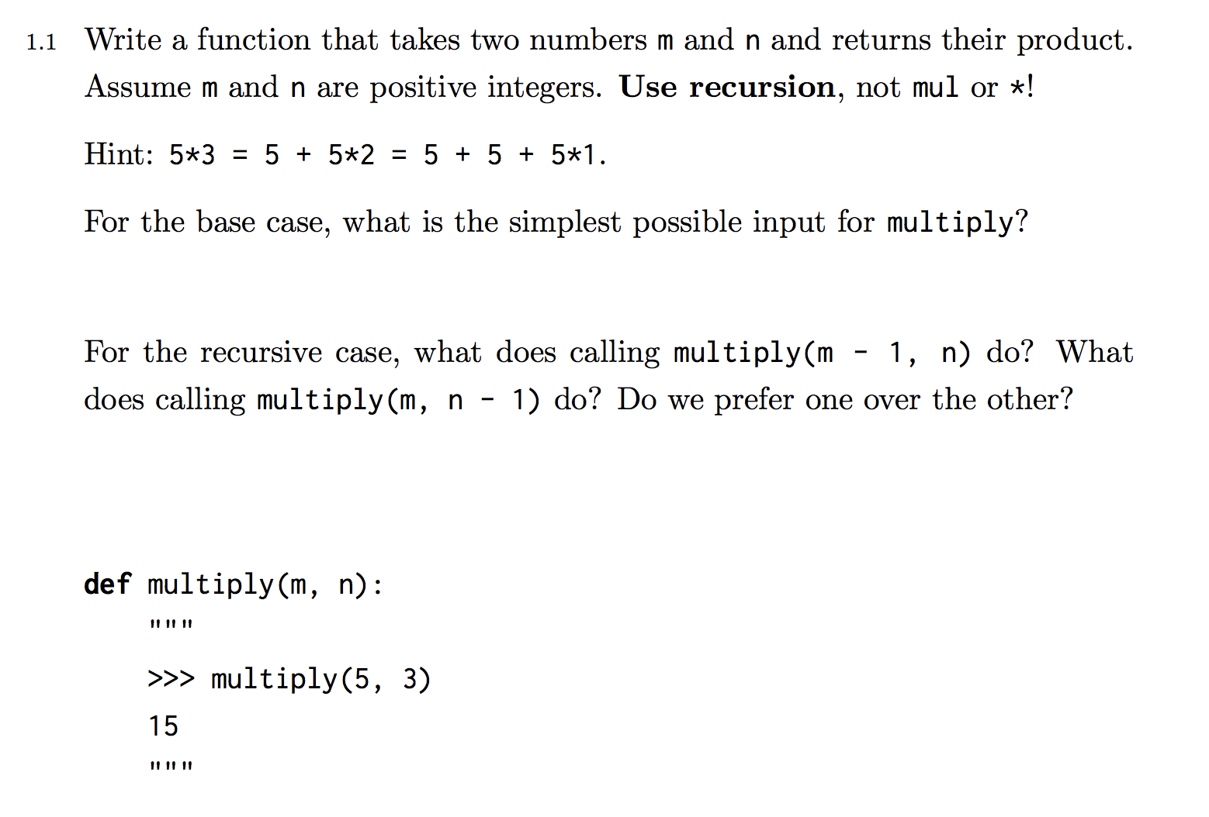
Practice 1.1

Slide 20
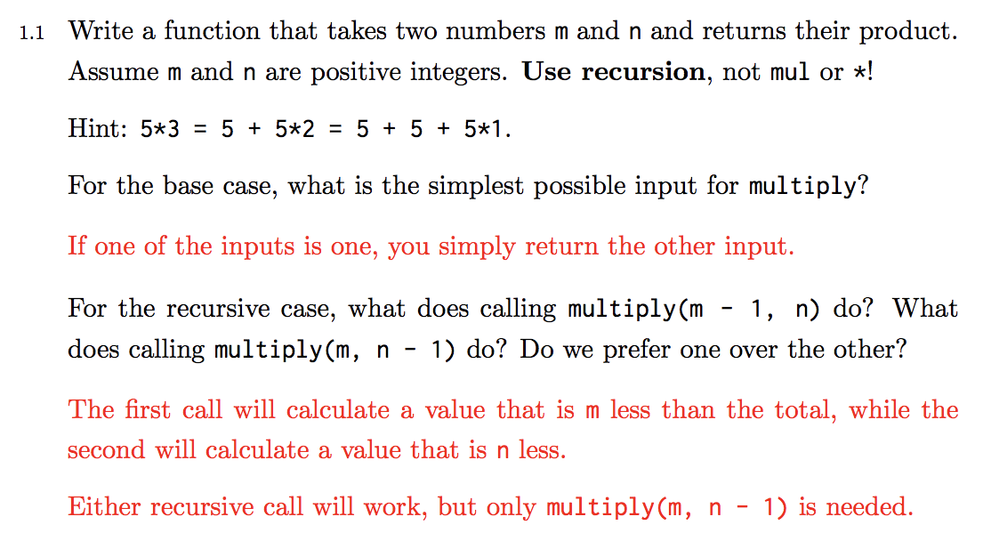
Practice 1.1 Solution

Slide 21
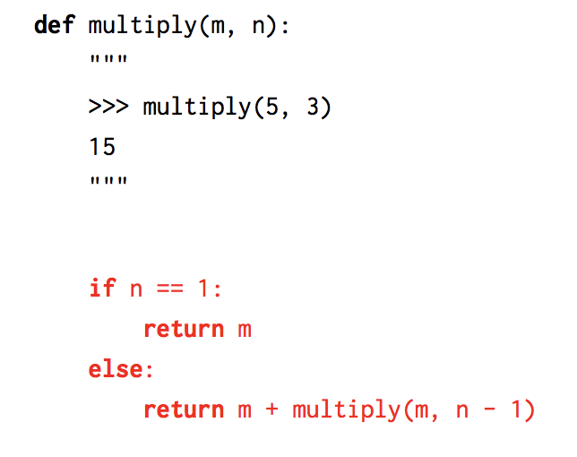
Practice 1.1 Solution

Slide 22
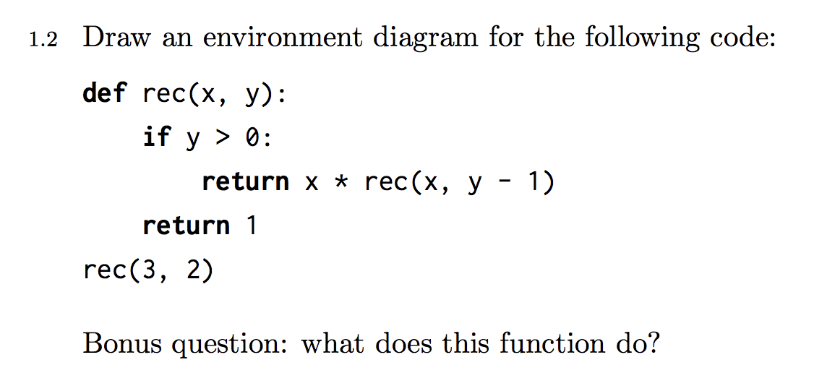
Practice 1.2

Slide 23
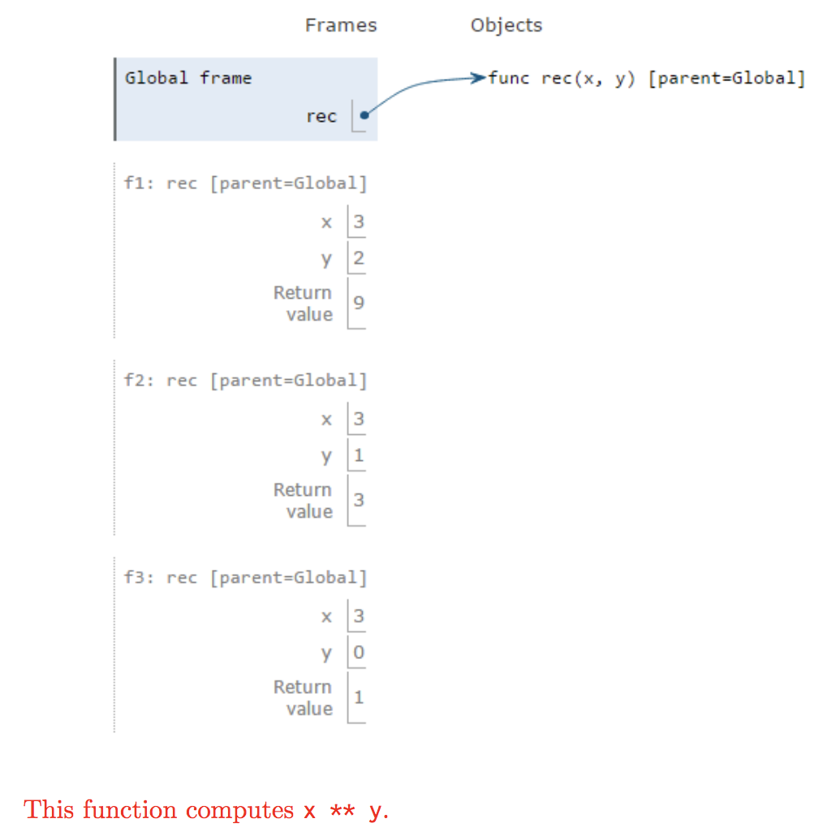
Practice 1.2 Solution

Slide 24
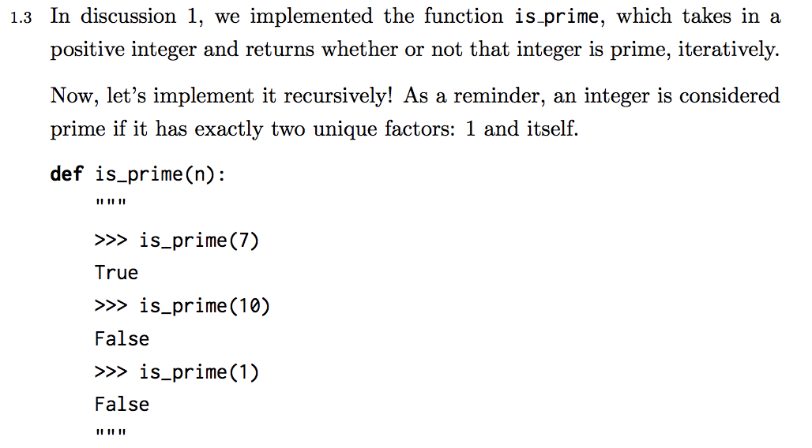
Practice 1.3

Slide 25
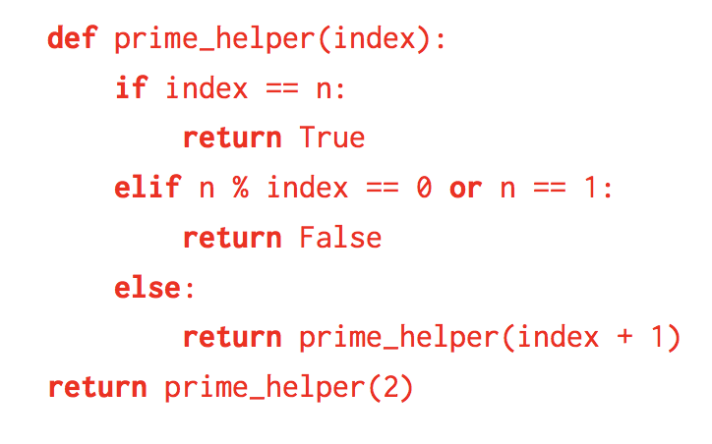
Practice 1.3 Solution

Slide 26
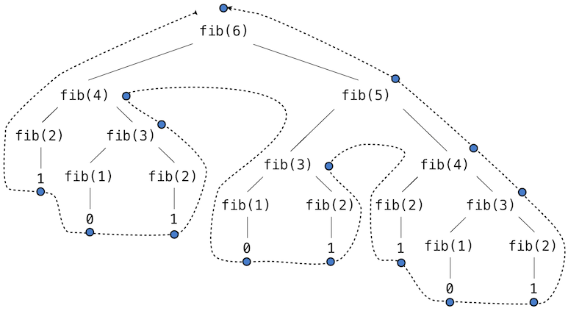
2
Tree Recursion

Slide 27
Tree Recursion
tree recursion: involves more than one recursive call

Slide 28
Tree Recursion
tree recursion: involves more than one recursive call
sometimes requires more than one base case in order for all recursive calls to be terminated

Slide 29
Tree Recursion
tree recursion: involves more than one recursive call
sometimes requires more than one base case in order for all recursive calls to be terminated
def fib(n):
if n == 0:
return 0
elif n == 1:
return 1
else:
return fib(n-1) + fib(n-2)

Slide 30
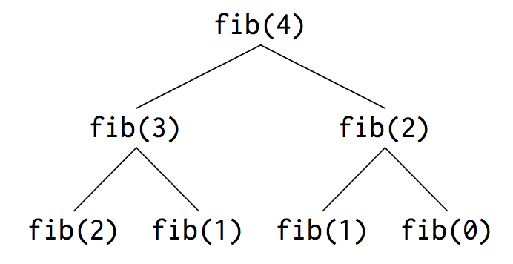
Tree Recursion
Recursive calls in upside down tree for fib(4) call

Slide 31
Tree Recursion
useful when you need to consider multiple possibilities! equivalent to exploring branches in a tree

Slide 32
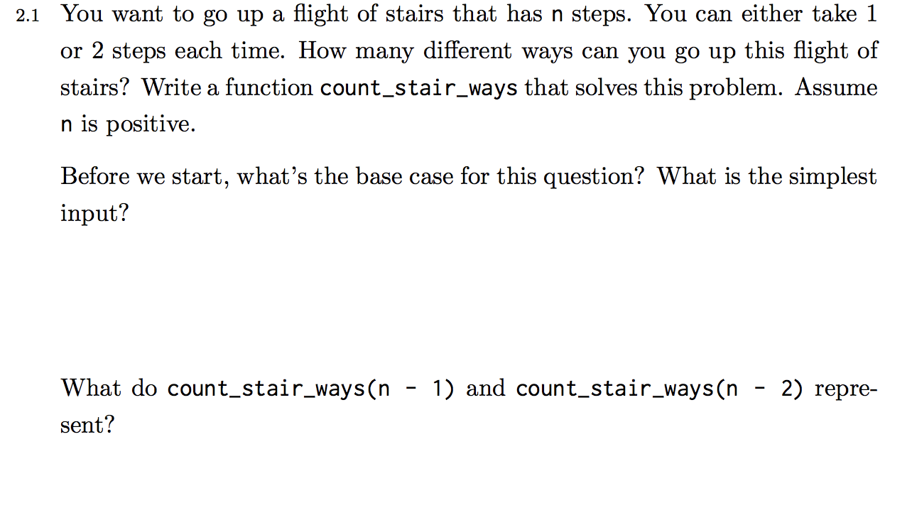
Practice 2.1

Slide 33
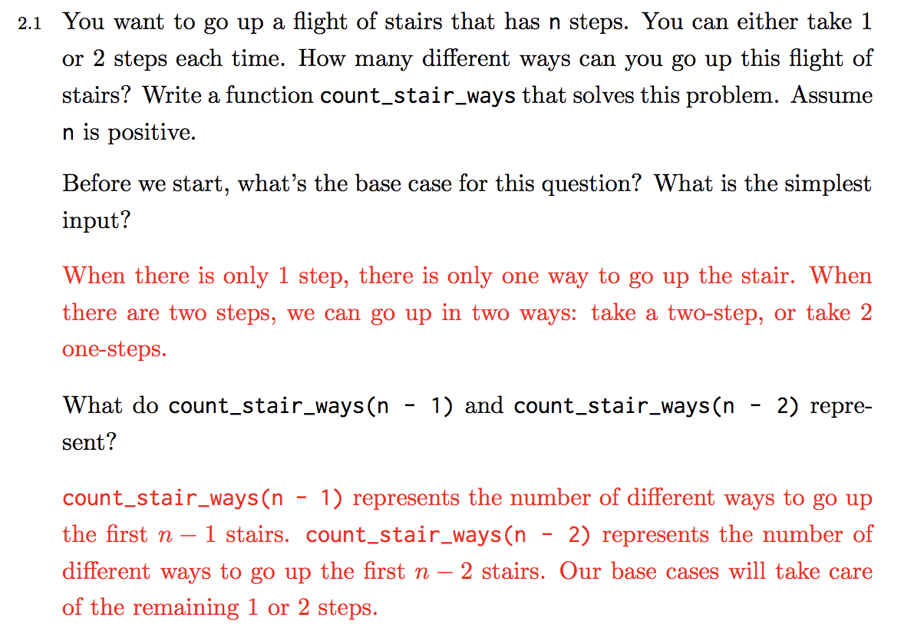
Practice 2.1 Solution

Slide 34
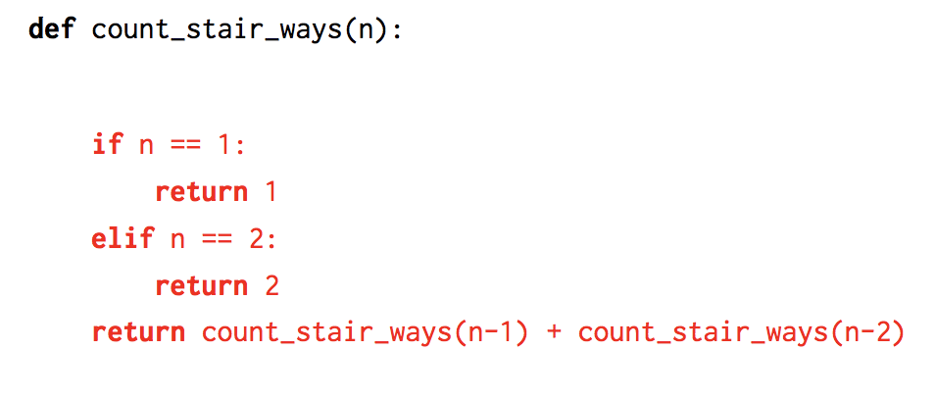
Practice 2.1 Solution

Slide 35
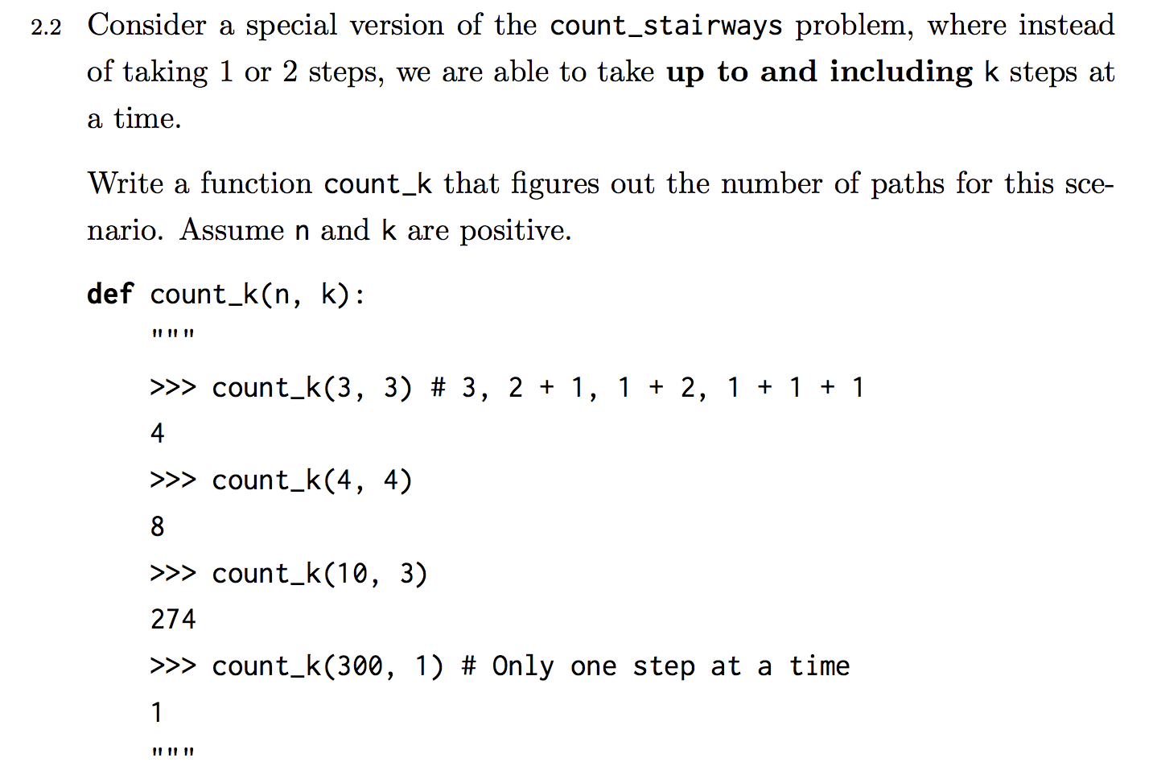
Practice 2.2

Slide 36
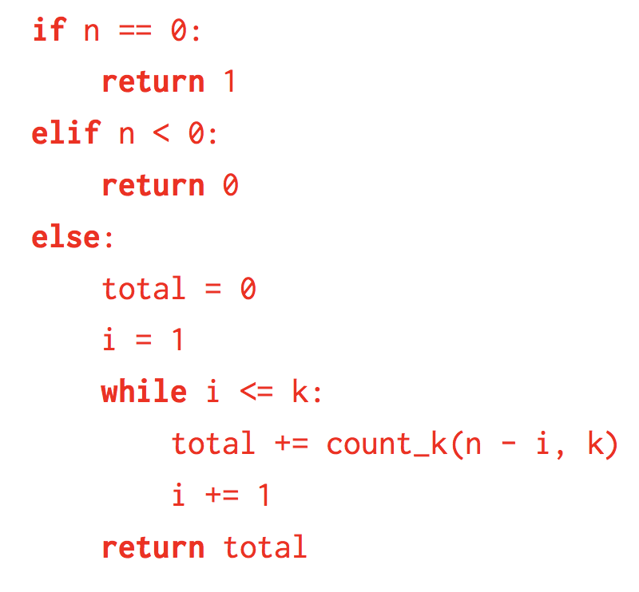
Practice 2.2 Solution

